Slide 1
AP Stats Ch5 Review Questions

Slide 2
2. Which of the following statements is FALSE?
(a) Nonresponse can cause bias in surveys because non-respondents often tend to behave differently from people who respond.
(b) Non-sampling errors are often bigger than the random sampling errors in surveys.
(c) Slight changes in the wording of questions can make a measurable difference in survey results.
(d) People will sometimes answer a question differently for different interviewers.
(e) Sophisticated statistical methods can always correct the results if the population you are sampling from is different from the population of interest, for example, due to undercoverage.
First cross off all the choices that are likely TRUE
a) TRUE: Non respondents are behaving differently b/c they are NOT responding
c) TRUE: This is wording bias
d) TRUE: This is response bias
b) No idea….. Go read “E” first
Answer: “E“ no statistical method can correct poor sampling selection, especially if you are sampling a population that is not of interest.

Slide 3
A properly conducted survey randomly selected 1000 Canadians (from a total population of about 30 million) and 1000 Americans (from a total population of about 300 million). Which of the following is FALSE? (a) Random selection ensures that both samples are representative of their respective populations (b) If 2000 Canadians and 2000 Americans were selected for the study, we could be confident that the sample result would be more accurate (c)A smaller proportion of the American population has been chosen. Therefore, a particular person has a smaller chance of being selected in America than in Canada
(d) A potential stratification variable for both countries could be location: eastern, middle, or western continental.
(e) Random digit dialing to select people for the survey could induce biases in the results if the characteristic of interest for the survey is related to income.
A) TRUE b/c if we take two samples of 1000 from each country, random selection allows the sample to be representative of their country
C) TRUE b/c 1 out of 300 million is smaller than 1 out of 30 million. So someone in America is less likely to be chosen
D) TRUE Since both countries are big, stratifying by geography would be ideal
E) TRUE: digital dialing would lead to undercoverage for those without digital access
Answer: “B” is false b/c the misrepresentation of the countries is still the same, thus having the same sample result

Slide 4
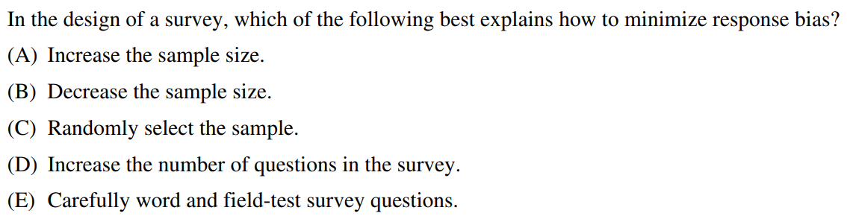
Response bias is when a person responds to a survey telling the interviewer what they want to hear
To prevent response bias, we need to word our questions carefully so people can not know the intent of the survey
Answer: “E” carefully wording your survey questions can help prevent participants from knowing what answers you want to hear.

Slide 5
Random assignment eliminates any variables amongst your treatment groups other than the treatment itself
In this case, it eliminates the time of day being a variable. Answer “D”

Slide 6
Stratified sampling surveys each strata
Answer “B”

Slide 7
In a SRS of 5000 mothers, only 1000 responded
There was no response from the other 4000 mothers
Concern: Non-Response bias

Slide 8
A recent survey by a large-circulation Canadian magazine on the contribution of universities to the economy was circulated to 394 people who the magazine decided “are the most likely to know how important universities are to the Canadian economy.” The main problem with using these results to draw conclusions about the general public’s perception is
(a) selection bias.
(b) insufficient attention to the placebo effect.
(c) no control group.
(d) nonresponse bias.
(e) interviewer bias
Not an experiment
Control groups are NOT needed, not an experiment
No mention of people in sample not responding
No idea what this is…..
Answer: “A” Selection Bias : the participants were selected by the magazine company.

Slide 9
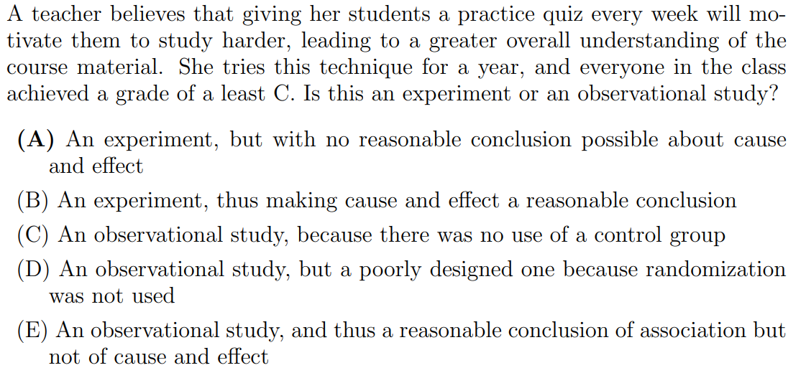
This is Not an Observational study since a treatment was given!
There is NO control group, so condition to establish causation is NOT met….
Answer: “A” 1. This is an experiment and not an observational study because a treatment was given to the students. 2. Since there is no control group, a reasonable conclusion about cause and effect CAN NOT be made

Slide 10
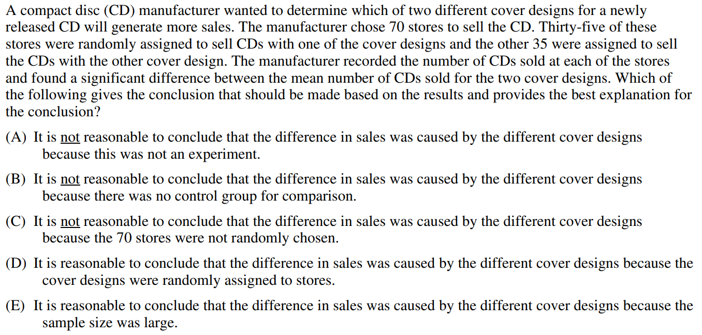
Answer: “D”

Slide 11
To test the effects of a new fertilizer, 100 plots were divided in half. Fertilizer A is randomly applied to one half, and B to the other. This is
(a) an observational study.
(b) a matched pairs experiment.
(c) a completely randomized experiment.
(d) a block design
Answer: “D”, definition of block design: Randomized Block Design. With a randomized block design, the experimenter divides subjects into subgroups called blocks, such that the variability within blocks is less than the variability between blocks. Then, subjects within each block are randomly assigned to treatment conditions.:

Slide 12
A biology teacher gives each of the 30 students in her class a pretest to assess their knowledge on fish anatomy. The teacher wants to compare the effectiveness of an instructional program in which students physically dissect fish vs the effectiveness of a different program where students use a computer simulation to dissect a fish. After completing one of the two programs, students will be given a test to assess their knowledge of fish anatomy. The teacher will then analyze the changes and differences in test scores.
a) Describe a method for assigning the 30 students to two groups of equal size that allows for a statistically valid comparison of the two instructional programs:
When answering this question, there are two criterias that must be addressed:
1. A proper method of randomization is described 2. Name the treatment and assign it to the groups
How to select the 2 groups:
1. Completely randomized – everyone gets an unique random (two digit) number generated by calculator, software, or table. Top 15 goes to group 1 and bottom 15 goes to group 2.
2. Randomized blocking: - students will be paired based on pre-test scores, lowest two together, then next two lowest and so on. Students in each group will be given a random number by calculator or software. Lower number goes to group 1 and higher number goes to group 2.
Describe the treatment:
Group 1 will receive the instructional program that requires hands-on dissection of fish.
Group 2 will receive the instructional program that uses computer simulation on dissection of fish

Slide 13
Suppose the teacher decided to allow students in the class to select which instructional program on fish anatomy they prefer to take (hands on vs computer). 11 chose hands-on and 13 chose computer simulation. How might the self-selection process jeopardize a statistically valid comparison of the changes in test scores (scores on post test minus pre-test) for the two instructional programs? Provide a specific example to support your answer:
What are we looking for in your example?
1. Give a reasonable characteristic of the self selected students in the study
2. Explains how this characteristic could be “associated” with changes in the differences between “pre” and “post” test scores
If this characteristic does not provide a strong association to changes in test scores, marks will be deducted.
Answer: BY not randomizing and allowing students to self select, there is a potential for changes to occur in the difference between pretest and post test scores for a particular group. These changes can be due to characteristics of students that choose a particular instructional method, rather than the instruction itself.
Students who already know a lot about fish may score very high on both test and thus see very little improvement in both test scores. These students may have already dissected fish before and choose the computer simulation. So, the little change in tets scores can be attributed to students already knowing a lot about fish.
Students selecting the hands-on instructional method may have less prior knowledge and thus showing a greater improvement in test scores.

Slide 14
A biologist studying the effects of growth enhancing nutrients and different salt levels in water on the growth of oysters. The biologist uses a large supply of “bluepoint” oysters. The experiment is to be conducted in a lab where 20 “bluepoint” oysters are placed randomly into each of 12 similar tanks in a controlled environment. The biologist plans to use different growth-enhancing nutrients (A,B,C) and two different salt levels (Low vs high)
a) List the treatments used in this experiment:
b) Design a completely randomized design that will allow the biologist to compare the shrimp’s growth after 3 weeks
c) Give one “statistical” advantage to having only “bluepoint” oysters in this experiment. Explain why this is an advantage
d)Give one “statistical” disadvantage to having only “bluepoint” oysters in this experiment. Explain why this is an disadvantage

Slide 15
a) There are 3 different enhancing nutrients and two different salt levels (high vs low). This yields 3 x 2 = 6 different treatment combinations for this experiment:
Treatment Combination
;Nutrient
Salt level
1
A
HIGH
2
A
LOW
3
B
HIGH
4
B
LOW
5
C
HIGH
6
C
LOW
You need to show the treatments are combined into the six different ways as follow. If you just list out: nutrients A,B,C, low salt level, and high salt level, your answer will be wrong!

Slide 16
b) Note: a randomized method must be used to assign the tanks.
You must also indicate that each treatment must be assigned to two of the 12 water tanks.
Answer: Since 10 oysters are placed in each of the 12 tanks, we must randomly assign the treatment combination to the tanks. One way to do this is to generate a random number for each tank. The treatment combinations are then assigned by sorting the random numbers from smallest to largest.
Treatment Combination
;Nutrient
Salt level
1
A
HIGH
Smallest two random numbers
2
A
LOW
3rd and 4th Smallest two random numbers
3
B
HIGH
5th and 6th Smallest two random numbers
4
B
LOW
5th and 6th Largest two random numbers
5
C
HIGH
3rd and 4th Largest two random numbers
6
C
LOW
Largest two random numbers

Slide 17
c) Using only bluepoint oysters will reduce a source of variation in the experimental units, the tanks of oysters in this experiment. By eliminating this possible source of variation, type of oysters, we are better able to isolate the variability due to the factors of interest to us (nutrient and salt level). This will make it easier to identify any treatment effects that may be present.
What are we looking for here?
Identify what statistical advantage if variability is reduced
Explains the association between reduced variability to increasing the likelihood of determining differences among treatments

Slide 18
d) What are we looking for:
Identifies the statistical disadvantage of limited scope of inference
An explanation that different species of oysters may respond differently to treatments provided
Answer: Using bluepoint oysters will limit the scope of inference for the biologist. Ideally, the biologist would like to identify the treatment combination that leads to the most growth for all oysters. However, the biologist may only be able to identify the best treatment combination for bluepoint oysters cause other types of oysters may respond differently to the treatments

Slide 19
Which of the following can be used to show a cause-and-effect relationship between two variables?
a)A census where all subjects are surveyed
b) A controlled experiment where lurking variables are controlled
c) An observation study where confounding variables are controlled
d) A sample survey with a large sample size
e) Nothing can prove a cause-and-effect relationship
Census, observational studies, and surveys CAN NOT establish causation
Answer: “B”, only an experiment with a control group and random assignment can be used to establish causation

Slide 20
When the difference between what we expect and what we observe in a study is unusually large and cannot be attributed to chance, the finding is:
Remarkable
Repeatable
Statistically significant
Insignificant
systematics
Answer: “C”
A Statistically significant result is defined as a result that could not have happened by chance.
This is a term we will use often. “statistically significant”: The results from our sample statistics are significant enough such that it could not be due to chance

Slide 21
A new drug for headaches was given to a group of 25 people who had headaches. Four hours after taking the new drug, 20 of the subjects reported that their headaches had disappeared. From this information, you can conclude which of the following?
The drug is an effective treatment for headaches
Nothing, because the sample size was too small
Nothing, because there is no control group for comparisons
The new drug is better than Tylenol
The drug is not effective for treating headaches
Answer: “C”, there is no control group for comparisons…

Slide 22
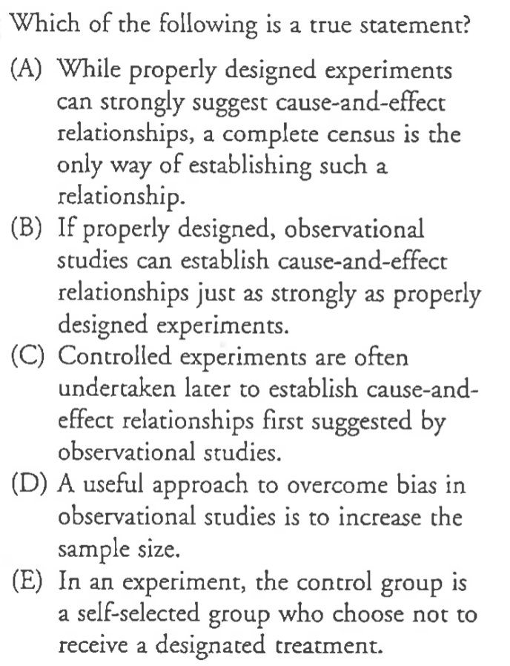
Answer: “C”

Slide 23
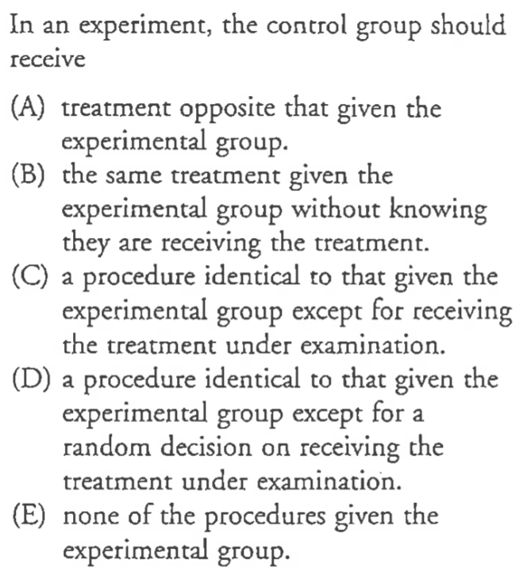
Answer: “C”

Slide 24
Answer: “A”

Slide 25
Sickle cell disease is a painful disorder of the red blood cells that affects mostly African americans. To investigate whether the drug hydroxyurea can reduce the pain associated with sickle-cell disease, a study by WHO gave the drug to 150 sickle cell sufferers and a placebo to another 150. The researchers then counted the number of episodes of pain reported by each subject.
Match each item with the correct name:
Hydroxyurea dose or placebo dose
Control Group
Hydroxyurea pill
Treatment levels
Number of episodes of pain
Subject
Explanatory variable
150 people that received placebo drug
Response variable
The 300 people in the study
Factors

Slide 26
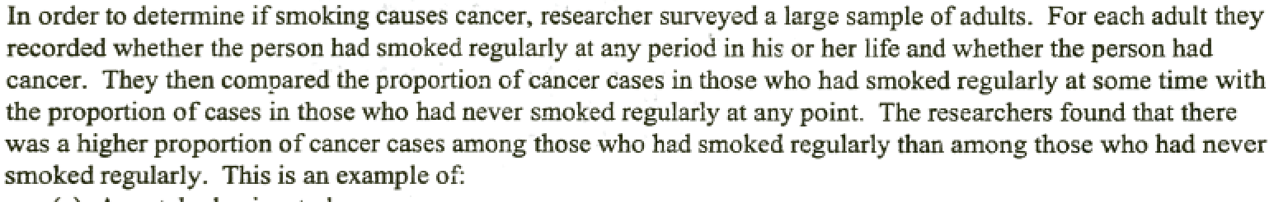
A matched pairs study
A double blinded experiment
A controlled experiment
A block design
An observational study
Answer: “E”, the subjects were not assigned, they were not given a treatment to smoke

Slide 27
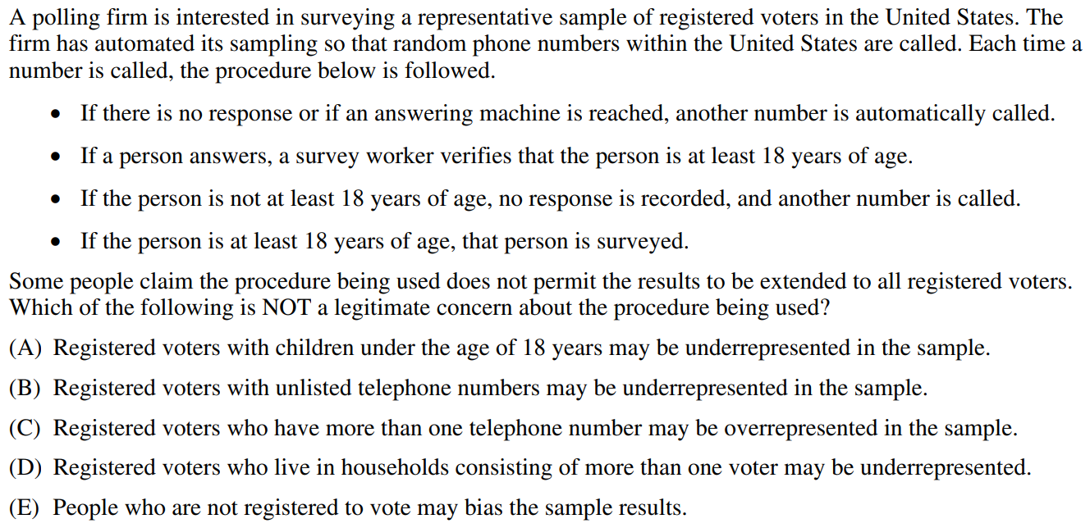

Slide 28
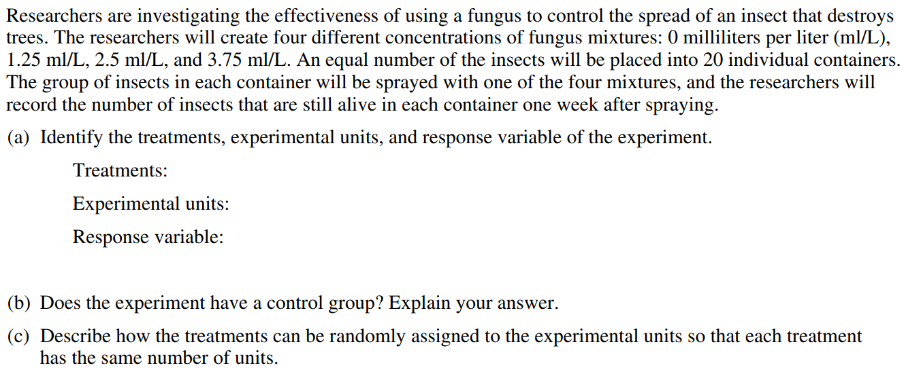

Slide 29
A school district wants to compare the effectiveness of a standard AP Statistics curriculum and a new “hands-on” AP Statistics curriculum. Two experienced teachers, Mr. P and Mr. L , each teach one class with the standard curriculum and one with the new approach. Students are assigned at random to these four classes. At the end of the year, all students take the AP Statistics exam. What are the subjects in this experiment?
(a) Mr. Pryor and Mr. Legacy.
(b) the two AP Statistics curricula.
(c) the students in the four classes.
(d) all students taking AP Statistics in Texas.
(e) only one: AP Statistics
Answer: “C”, the subjects are the people receiving the treatment.

Slide 30
In the previous question, what are the factor(s)?
(a) has one factor: the AP Statistics curriculum a student is assigned to.
(b) has two factors: the AP Statistics curriculum and the teacher a student is assigned to.
(c) has two factors: the standard curriculum and one with the hands-on approach.
(d) has three factors: the math curriculum, the teacher, and the class a student is assigned to.
(e) has three factors: the standard curriculum, the hands-on approach, and the teacher a student is assigned to.
Answer: “A”, the factor is the explanatory variable in the experiment. We are experimenting which AP Stat curriculum is better.

Slide 31
A class in marketing designs two videos advertising an expensive Rolls Royce car. They test the videos by asking fellow students to view both (in random order) and say which makes them more likely to buy the car. Rolls Royce should be reluctant to agree that the video favored in this study will sell more cars because
(a) there is no control group to establish a cause and effect association.
(b) there is no placebo and no control group
(c) the study used a matched pairs design instead of a completely randomized design.
(d) this is an observational study, not an experiment.
(e) the study was performed students that may be different from the population of interest. Ie: results from students may not generalize to the older and richer customers who might buy a Rolls Royce
Answer: “E”, the factor is the explanatory variable in the experiment. We are experimenting which AP Stat curriculum is better.

Slide 32
Vitamin E may have special health benefits
Large doses of vitamin E apparently can reduce harmful side effects of bypass surgery in heart patients. A study involving 28 bypass patients found that the 14 patients who took vitamin E for two weeks before their operations had significantly better heart function after the procedure than the 14 patients who took placebos.
The vitamins apparently prevent damage to the heart muscle by destroying the toxic chemicals, called free radicals, that form when blood is cut off during the surgery, said Dr. Terrance Yau of the University of Toronto.
(a) Describe the experimental units/subjects in the experiment. How many were there?
(b) Identify the explanatory variable(s).
(c) How many treatments were there? List them.
(d) How many subjects were in each treatment group?
(e) What was the response variable?
28 heart bypass surgery patients
Taking Vit. E 2 wks prior to surgery
2 treatments: 1. Vitamin E 2. Placebo (control)
There were 14 subjects in each group
Heart function after surgery

Slide 33
Suppose there are 500 students in your school. Starting with line 125 of the random digits table, shown below, select the first 5 students in a simple random sample (SRS) of 20 students
Assign students a number from 001 to 500 (3 digit number)
The first 5 students will be: 461, 214, 235, 119, and 033

Slide 34
A political pollster is seeking information on public attitudes toward funding of pornographic art by the National Endowment for the Arts (NEA). He asks an SRS of 2000 U.S. adults, “Rather than support government censorship of artistic expression, are you in favor of continuing federal funding of artists whose work may be controversial?” 85% of those surveyed answer “yes.”
Is Bias present in the sample above? Identify the type of bias involved and state whether if the proportion obtained is higher or lower than the true population?
Wording of question is very biased. The reference to Gov’t Censorship usually causes more respondents to favor the other position, which in this case is to continue federal funding of artwork that may be controversial. The 85% is probably much higher than the opinions of actual population.

Slide 35
In 2003, the AARP conducted a survey of their members (people over age 50) on proposed Medicare legislation. One of the questions was: “Even if this plan won’t affect you personally either way, do you think it should be passed so that people with low incomes or people with high drug costs can be helped?” Is Bias present in the sample above? Identify the type of bias involved and state whether if the proportion obtained is higher or lower than the true population?
Selection bias and undercoverage. Only people 50 yrs old or over were surveyed. Older people are more susceptible to illness or health concerns. Thus may over represent a population that needs supplement to health cost coverage.

Slide 36
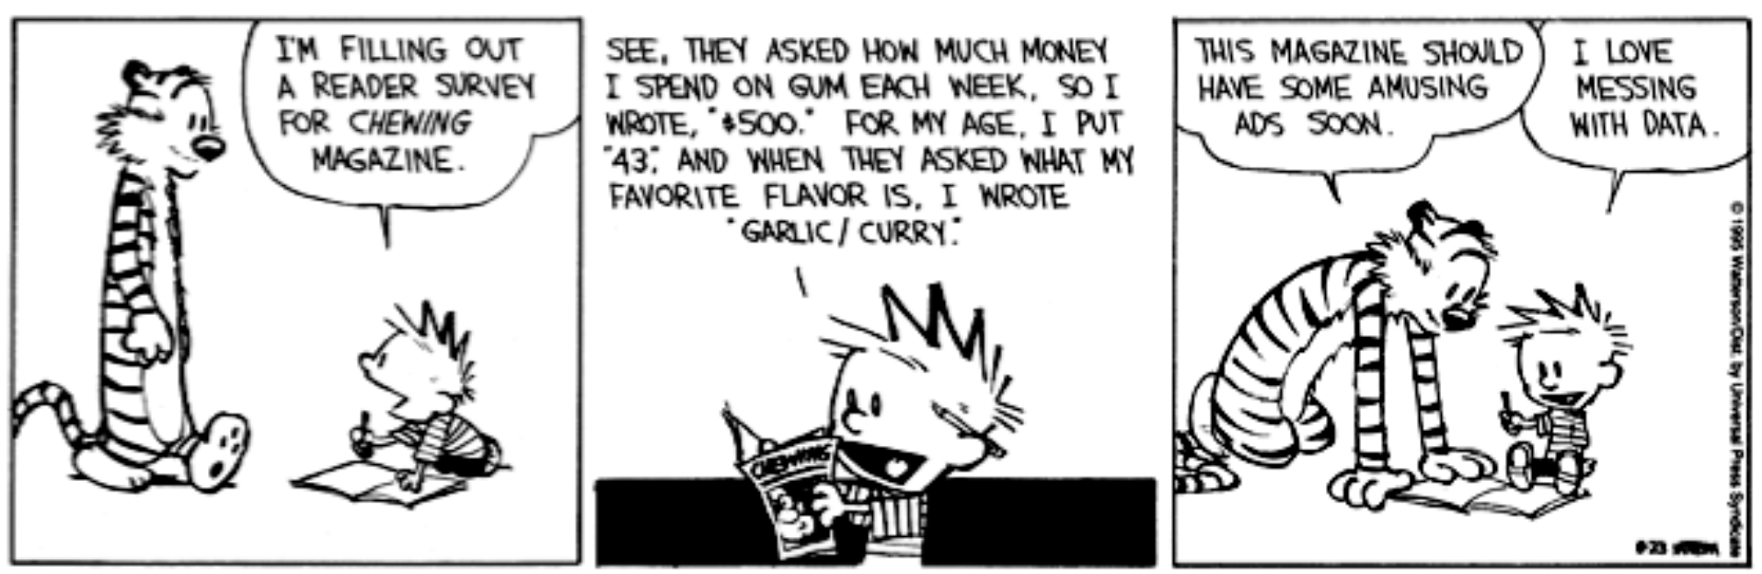
What type of bias is Calvin introducing into the survey he’s taking?
Calvin is purposely lying when answering the survey. This is termed “Response Bias”

Slide 37
